Slide 1



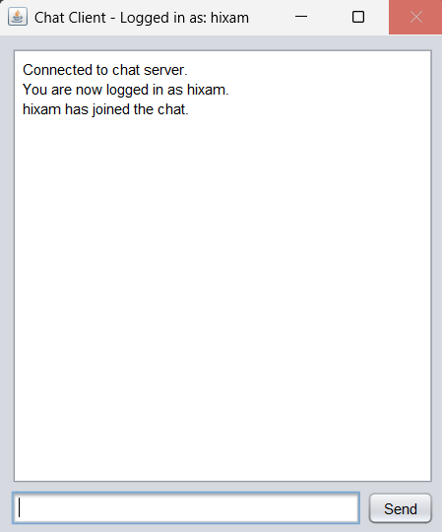
Page 1
Page 2
Page 3
Page 4
Page 5
Page 6
Page 7
Page 8
Page 9
Page 10
1
2
3
4
5
6
7
8
9
10
11
12
13
14
15
16
17
18
19
20
21
JAVA CHAT APPLICATION
Presented By
Hisham Ahmed (24FA-013-CS)
Laiba Khan (24FA-053-CS)
Chat Application

Slide 2
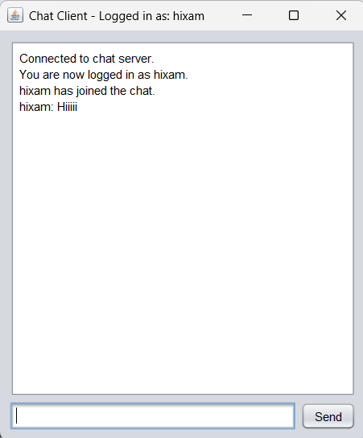


Page 1
Page 2
Page 3
Page 4
Page 5
Page 6
Page 7
Page 8
Page 9
Page 10
1
2
3
4
5
6
7
8
9
10
11
12
13
14
15
16
17
18
19
20
21
INTRODUCTION
About this Project:
  A simple, real-time chat application built using Java.
  Demonstrates client-server architecture, database integration, and GUI development.
Why a Chat Application?
Core Idea:
  Facilitates instant communication between users.
  Provides a practical example for learning network programming and concurrent
  Connect multiple users through a central server
chat Application

Slide 3

Page 1
Page 2
Page 3
Page 4
Page 5
Page 6
Page 7
Page 8
Page 9
Page 10
1
2
3
4
5
6
7
8
9
10
11
12
13
14
15
16
17
18
19
20
21
CORE FUNCTIONALITY
User Authentication:
Real-time Messaging:
Centralized User Management:
Graphical User Interface (GUI):
  New user registration.
  Secure login for existing users.
  Send and receive messages instantly.
  Messages broadcast to all connected users.
  User data stored in a persistent database.
  Intuitive, interactive interface for user interaction.
Chat Application

Slide 4


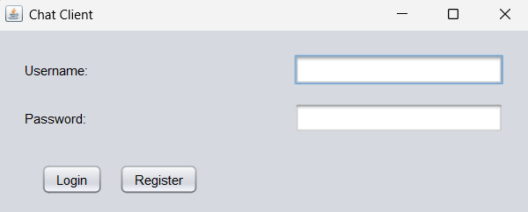

Page 1
Page 2
Page 3
Page 4
Page 5
Page 6
Page 7
Page 8
Page 9
Page 10
1
2
3
4
5
6
7
8
9
10
11
12
13
14
15
16
17
18
19
20
21
KEY COMPONENTS
Chat Server
SQL Database
Manages Connections and Messages
Stores User Account Details
Chat Client
The User Interface, allows User Interaction
Chat Application

Slide 5



Page 1
Page 2
Page 3
Page 4
Page 5
Page 6
Page 7
Page 8
Page 9
Page 10
1
2
3
4
5
6
7
8
9
10
11
12
13
14
15
16
17
18
19
20
21
TECHNOLOGY USED
Database Connectivity:
  JDBC (Java Database Connectivity) used to connect program to database.
Programming Languages and Framework:
Development Tools:
  Java (JDK 24) used for development
  Java Swing Framework used for GUI
  SQL Lite used for databases
  Apache Netbeans IDE used for development
  PowerShell for compiling the code.
Deployment:
  JAR Files
  Batch Scripts
Chat Application

Slide 6
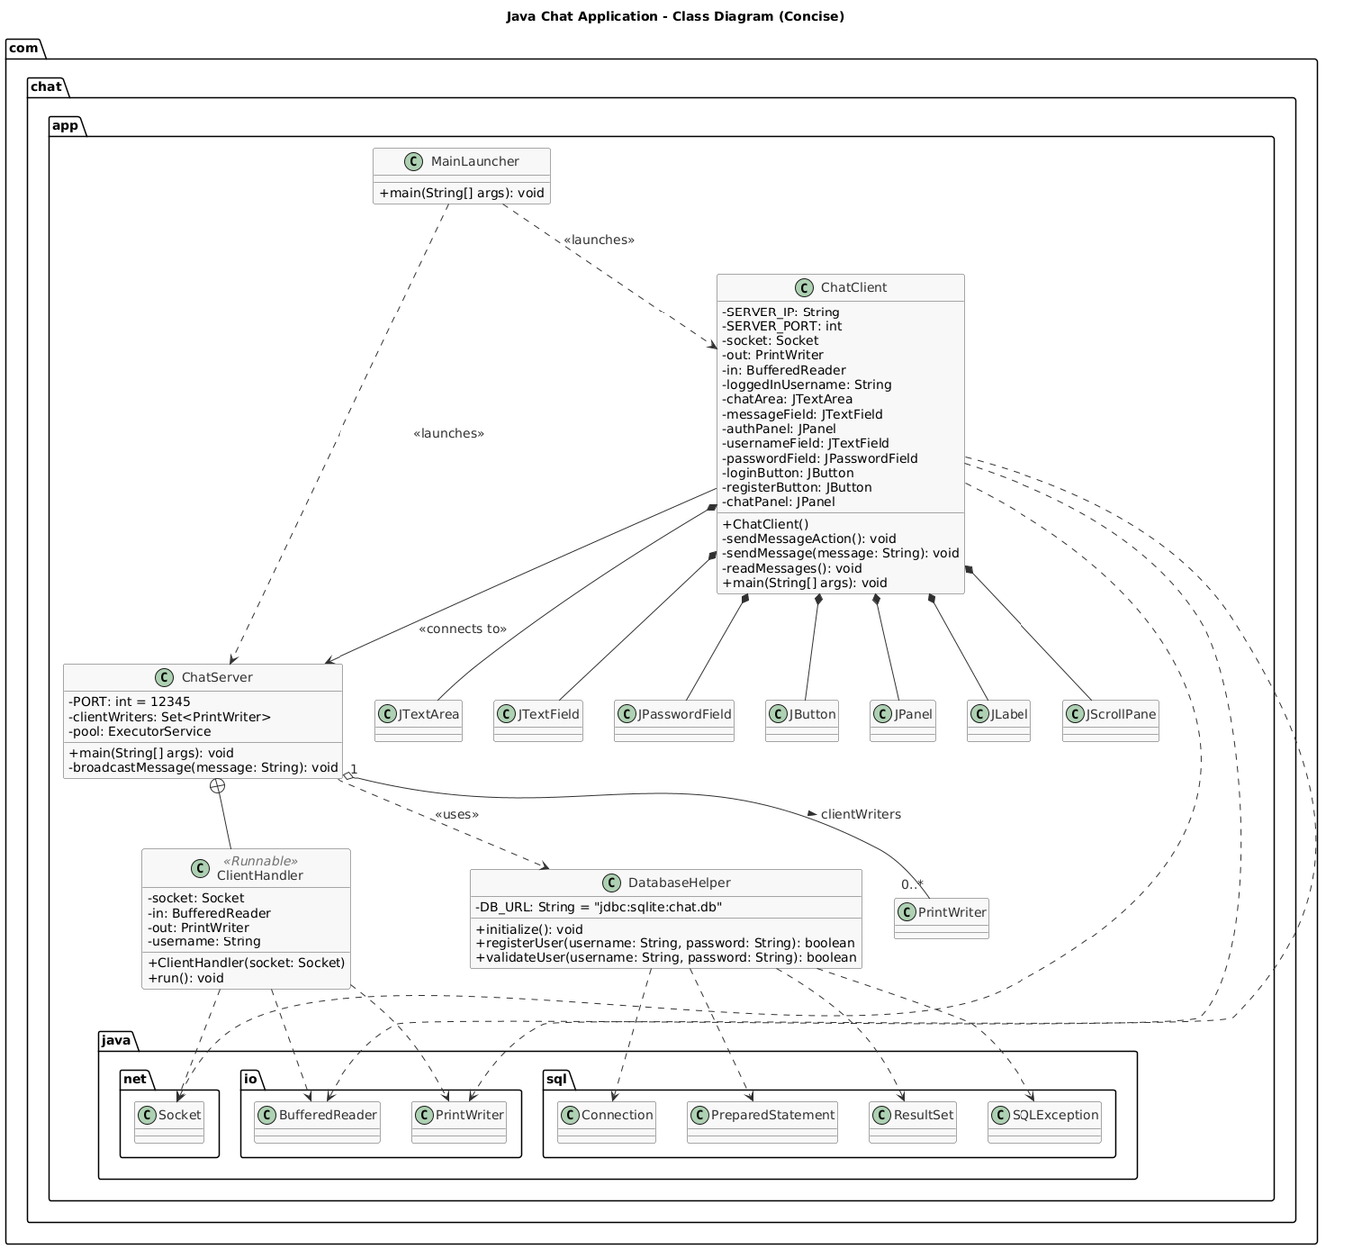
Page 1
Page 2
Page 3
Page 4
Page 5
Page 6
Page 7
Page 8
Page 9
Page 10
1
2
3
4
5
6
7
8
9
10
11
12
13
14
15
16
17
18
19
20
21
Chat Application

Slide 7


Page 1
Page 2
Page 3
Page 4
Page 5
Page 6
Page 7
Page 8
Page 9
Page 10
1
2
3
4
5
6
7
8
9
10
11
12
13
14
15
16
17
18
19
20
21
Front and Back End Deep Dive
ChatServer.java:
ChatClient.java
Listens to oncoming connections through port. Authenticates users by interacting with DatabaseHelper. Broadcasts messages to all clients.
Provides the user interface for the chat application. Connects to the server's IP address and port. Manages two main views: Authentication Panel and Chat Panel. Sends user input (credentials, chat messages) to the server.
DatabaseHelper.java:
GUI Enhancements:
Manages chat.db (SQLite). Handles user registration (adds to users table). Validates user credentials for login.
Utilizes Nimbus Look and Feel for a modern appearance. Improved layout with padding and spacing. Automatic scrolling of chat area to new messages.
Chat Server
Database Helper
Chat Client
GUI
Chat Application

Slide 8

Page 1
Page 2
Page 3
Page 4
Page 5
Page 6
Page 7
Page 8
Page 9
Page 10
1
2
3
4
5
6
7
8
9
10
11
12
13
14
15
16
17
18
19
20
21
HOW IT WORKS:
Launch and Connection:
Launch: launch_chat.bat starts server in background and after 15 seconds starts the client GUI.
Connections: Connects clients to the server on port 12345
Authentication and Chatting:
Authentication: Client sends LOGIN_REQUEST / REGISTER_REQUEST. Server receives, DatabaseHelper validates/registers user. Server sends LOGIN_SUCCESS / REGISTER_FAILED back to Client.
Chatting: Logged-in Client sends chat message. Server receives, prefixes with username. Server broadcastMessage to all other logged-in Clients. Clients receive and display message in JTextArea.
Chat Application

Slide 9
Page 1
Page 2
Page 3
Page 4
Page 5
Page 6
Page 7
Page 8
Page 9
Page 10
1
2
3
4
5
6
7
8
9
10
11
12
13
14
15
16
17
18
19
20
21
CONCLUSION
Successfully developed a functional Java chat application demonstrating:
Fundamental client-server communication. Basic user authentication and persistence with SQLite. Concurrent programming in Java. GUI development with Swing.
Future Enhancements:
  Enhanced Security: Password hashing & salting, SSL/TLS encryption for communication.
  Extended Chat Features: Private messaging, online user list, message history, file sharing.
  Improved Scalability: Migrate to a more robust database (e.g., MySQL), advanced server architecture.
  Advanced GUI: Custom themes, notifications, user profiles.
Chat Application

Slide 10
Page 1
Page 2
Page 3
Page 4
Page 5
Page 6
Page 7
Page 8
Page 9
Page 10
1
2
3
4
5
6
7
8
9
10
11
12
13
14
15
16
17
18
19
20
21
Thank You!
Yes
No
Chat Application

